Slide 1
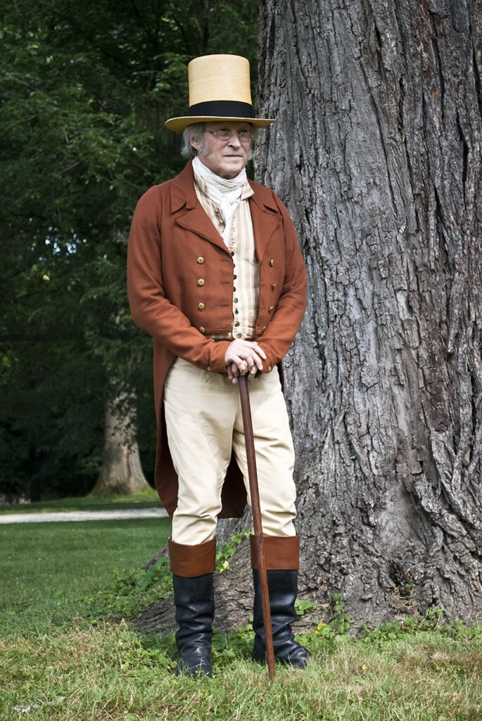
The Story of Dr. William Beanes III
Louis F. Giles

Slide 2
Dr. William Beanes III
Born 24 Jan 1748/1749 at Brooke Ridge, Upper Marlboro, PG, MD, dies 12 October 1828 in Upper Marlboro
Father: William Beanes (abt. 1715-1801)
Mother: Mary Bowie (1726-1794)
Wife: Sarah Hawkins Hanson (1750-1822) on
25 Nov 1773
Notes:
Father: wealthy plantor – left considerable land. 10 children. Mother: Sister of Gov Robert Bowie. Both children of Scotch immigrants Christopher Beanes immigrated 1671. William 3rd Generation born in MD Wife – niece of John Hanson, President of Continental Congress, cousin Alexander Contee Hanson – sister Chloe

Slide 3
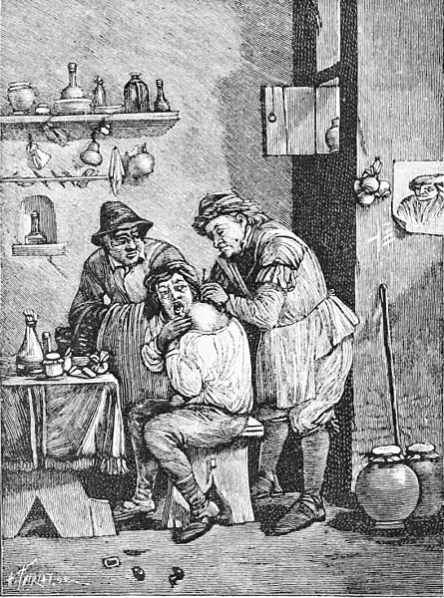
Revolutionary War Period
As no medical schools, Beanes apprenticed under local doctor and by 1776 was an established physician in Marlboro
1776-79 worked as surgeon in Philadelphia General Hospital, treating American troops
Returned to Upper Marlboro in 1779 – received land from father and purchased other land
Built house in outskirts Upper Marlboro on 144 acre Academy Hill
Stored Maryland State Records on his property on several occasions
Notes:
Grew up with notables such as John Carroll, first RC archbishop in US; Daniel Carroll signer of Constitution; John Rogers delegate to 2nd Continental Congress; Robert Bowie – governor of Maryland. founding member of the Medical and Chirurgical Facility of the State of Maryland

Slide 4
War of 1812
In August 1814, Dr. Beanes was 65 years old
First senior warden Trinity Protestant Episcopal Church (1810)
Owned many farms, grist mill, & slaves inherited from father
Still provided local medical care, although on a more limited basis
Founding member of the Medical and Chirurgical Facility of the State of Maryland (1799)
Federalist
Most prominent and perhaps most wealthy resident of Upper Marlboro
Popular and respected by the community

Slide 5
Dr. Beanes and MG Robert Ross What really happened?
Sources
BG Winder letter to MG Ross, August 31 1814. See Marine.
F.S. key letter to Mother, 2 September, 1814
George Gleig, A Subaltern in America, 1821.
George Gleig, Narratives of the campaigns of the British army at Washington and New Orleans, in the years 1814-1815, 1821.
Skinner letter to Baltimore Patriot, June 1849.
Taney recollections of F. S. Key, 1856. Letter in “Poems of the late F.S. Key”
Anna Hanson Dorsey, September 1861. Letter to Washington Sunday Morning Chronicle
Report of the Trial of John Hodges, Esq. on a Charge of High Treason, 3rd United States Circuit Court for the Maryland District, 1815.
Claim Harriet Brooke, War of 1812 Indemnity, Case 600, Calvert County, March, 1825
Claim of Ann Sprigg, War of 1812 Indemnity, January 1823
Notes:
Paper of Jennifer Eliza Smith 2016 University of Maryland Law Review

Slide 6
Winder letter to MG Ross – 31 August 1814
Party from your army took Dr. Beanes a respectable and aged old man, treated him with great rudeness and indignity and carried him aboard your ships
He is honorable man and would not be guilty of any intentional act contrary to the usages of war
Mentions other prisoners: Doctor Hill and Philip Weems
Bearer of message: Col Richard West [brother-in-law of Francis S. Scott]
Key letter to mother – 2 September 1814
I am going in the morning to Baltimore. British have taken prison old Dr. Beanes of Marlboro. His friends have urged me to intercede on his behalf.
Notes:
Col Richard West of the Woodyard – wife was Maria Lloyd sister of Francis Scott Key wife Mary Tayloe Lloyd

Slide 7
Gleig: Subaltern (1821)
Ordered not to harm town
Dr Bean medical practitioner with valuable farm one of few inhabitants in town
Migrated 20 years ago from Scotland, still had accent
Federalist – hostile to war with England, treated us like friends
“Wily emigrant was no loser by his civility”
While we took provisions and even horses, he was paid full value

Slide 8
Gleig: Recollections (1821)
After arriving at Nottingham, cavalry sent back to pick up stragglers
Inhabitants of Malboro, at the instigation of a medical practitioner, Bain, had taken some stragglers prisoners and put others to death according to information from soldier who had escaped
Troopers pulled doctor from his bed and mounting him before one of the party brought him to camp

Slide 9
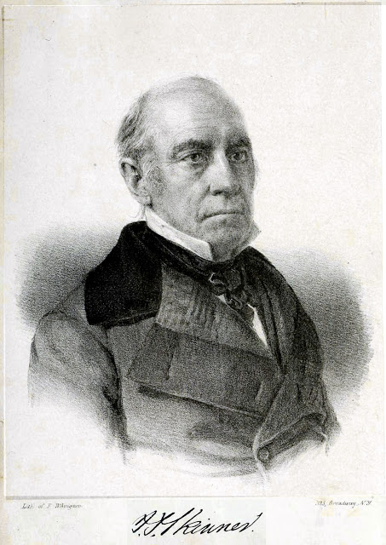
Account of John S. Skinner - 1849
Instructed by Gen Mason to take Key with him on planned trip to discuss prisoners from Bladensburg engagement
Key’s friends hoped there was something to be gained from Key’s tact and persuasive manners
Boarded flag ship, delivered messages, and asked to remain for dinner with the Admiral
Met MG Ross (first encounter)
Ross took Skinner aside and stated that based on the request from the Commissary General of Prisoners and letters from his men, he would release Dr. Beanes on that account and not of his own merit
Based on ship’s logs, Ross had already ordered Beanes release who joined Skinner and Key late that evening on HMS Surprize.

Slide 10
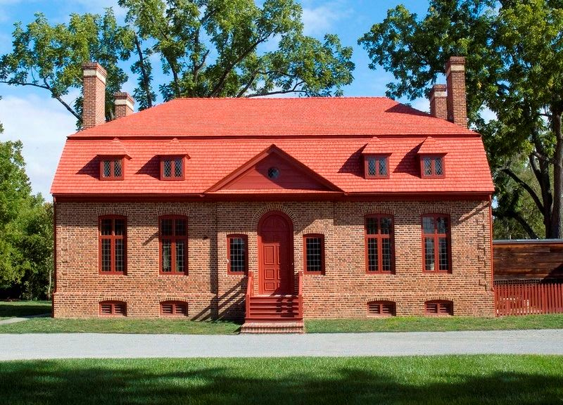
Trial of John Hodges - 1815
Prominent Upper Marlboro attorney with many large landholdings
Tried for high treason in 1815 for returning captured British prisoners back to the British in August 1814. Only treason trial of War.
Depositions of 13 witnesses (including British deserter) provide specific, non-conflicting details of the events leading up to Dr. Beanes imprisonment by MG Ross
Supreme Court Justice Gabriel Duvall presided sitting as Chief Justice of the Third Circuit Court of the United States for Maryland District
Opined that defendant was guilty
Jury immediately and unanimously produced verdict of not guilty
Notes:
Darnalls Chance -

Slide 11
The Facts per the Witnesses
Saturday, 26 August, Gen Robert Bowie sent son & Mr Oden to scout the enemy
That afternoon, Bowie attended afternoon dinner party at Dr. Beanes’ farm and on the way encountered enemy soldier (Holden) who surrendered (deserted)
Beanes and brother Bradley Beanes took deserter to William Lansdale in Upper Marlboro who later took him to be guarded by John Randall and Thomas Sparrow at Queen Ann
Dr Beanes organized some guests to go in “pursuit of British stragglers”
John Donaldson, Esq declined saying “the town had capitulated and he believed it not honorable”
Captured three soldiers who were sent to Upper Marlboro jail
Citizens of UM alarmed in harboring British soldiers, Bowie asked John Hodges and his brother to take captured soldiers to Queen Ann and notified governor
Late Saturday night, 50 British cavalry, led by Major Evans, searched Bradley Beanes’ house and other homes and “carried off” Dr. Beanes, Dr Hill and Philip Weems
Evans stated prisoners must be returned by noon Sunday or town would be destroyed

Slide 12
Early Sunday, Bowie heard about Beanes’ capture and rode to Queen Ann and said prisoners must be returned, but not deserter
Prisoners, including deserter, given to Hodges after argument with Randall – Hodges saying he knew what he was doing- the town was in panic and their families were at risk.
Robert Bowie had captured another deserter, who was at his home. He said he would not give up the deserter stating he did not live in town and was not a party to the town’s agreement. Was told by Bradley Beanes not to worry, the deserters will be given the opportunity to escape.
Around 11 AM Sunday, Robert Bowie, Jr., John Hodges, Brookes, Gustavus Hay and Benjamin Oden rode out with prisoners and deserters to meet British.
The deserters were left with Hodges and Oden at a house
Bowie and Brookes rode ahead to attempt to meet with Ross and specifically ask his demands. After riding about halfway to Nottingham, they met up with Major Evans column who when seeing four prisoners, demanded the other two.
As Bowie and Brookes pointed to the house a mile away, Hodges released the deserters.
Evans broke into the house, knocked Oden down and demanded the prisoners. A woman pointed to the direction the deserters had fled.
Evans gave chase and later captured the deserters, although Holden later escaped.

Slide 13
War of 1812 Indemnity Claims
Claim of Harriet Brooke for slaves – 2 March 1825
Deposition of Dr. William Beanes
End of August, he saw her slave while he was a prisoner on board the British brig Thetis in the Patuxent.
He was on HMS Thetis for 2 weeks and then moved to HMS Recruit
Claim of Ann Sprigg for slaves – 18 January 1823
Deposition of Phillip V. Weems
When he was carried on board a British brig in late August 1814 in the Patuxent, he saw her slave

Slide 14
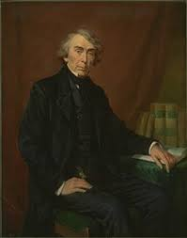
Account of Roger Taney from F.S. Key - 1856
After Dr. Beanes was taken, his friends went to headquarters of British Army to solicit his release. They were not allowed to see him and their request was refused.
On 2 September, Richard West of the Woodyard arrived at Mr Key’s residence. Beane’s was West’s personal physician and intimate friend of Mr. Key. [West was married to Maria Lloyd, sister of Key’s wife Mary Lloyd]
British treated Beanes not as prisoner of war but as one who had deceived and broken his faith to them.
Key agreed, received government permission, and joined Skinner in Baltimore
After this, generally agrees with Skinner account, except for meeting with Beanes on Tonnant – not mentioned by Skinner or supported by HMS logs

Slide 15
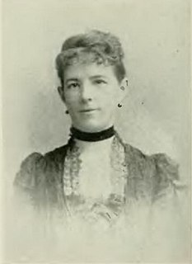
Account of Anna Hanson Dorsey (1815-1896)
Granddaughter of Dr. Beanes’ wife’s sister Anna Hanson
Mother Chloe was at Beanes’ dinner party and recalled the events
Key was friend of Dr. Beanes through Key’s wife and sister-in-law
True patriot and as a gentlemen treated his guests with courtesy
Beanes was hosting dinner party on afternoon of British return through Marlboro.
Due to patriotism and too much punch, these heroes of the Revolution decided
to round up and arrest stragglers
Beanes was awakened at midnight by British cavalry, sent to look for stragglers
who had been told by escapees of the earlier “round up”
Arrested, taken by horse, and put on the British fleet as a prisoner
Allowed no courtesies or communication
Friends approached President to consent to allow F.S. Key to negotiate release
After release in Baltimore, Key accompanied Beanes to his farm before departing for Frederick
Forever after, when Dr. Beanes aggravated his wife, she would threaten to send for ADM Cockburn
Notes:
Anna Hanson married Nicholas Lingan brother of Gen James Lingan killed in Baltimore 1812 riot. Article written 1861

Slide 16
Summary
22 August - Dr. Beanes provided MG Ross the “capitulation of the town” of Upper Marlboro
24 August - Battle of Bladensburg
26 August - Dr. Beanes held dinner party at his farm for friends and led a party of Marlboro residents to imprison British stragglers – possibility of too much alcohol
26 August - Midnight - Dr. Beanes, along with Philip Weems and Dr. William Hill, taken from their homes by British Major Evans and imprisoned on HMS Thetis in Patuxent
27 August - Noon – Captured British prisoners returned to British by townsmen
28 August - Weems and Dr. Hill released by British
30 August - British fleet departs Nottingham
3 September - Beanes transferred to HMS Recruit; F.S. Key departs Georgetown for Baltimore
5 September - Key and Skinner depart Baltimore to meet with British
8 September - MG Ross releases Dr. Beanes and transfers him to HMS Surprize with Key and Skinner
15 September – Key, Beanes, and Skinner arrive in Baltimore
17 September - Key escorts Beanes to Upper Marlboro

